Slide 1

ADVANTAGES OF FAST COMMUNICATION IN TODAY’S WORLD
TEAM 6
16.10.2023

Slide 2
ADVANTAGES OF FAST COMMUNICATION IN TODAY’S WORLD
TEAM 6
16.10.2023

Slide 3

INDEX
INTRODUCTION
Enhanced Productivity
Global Connectivity
Real-time Information
Cost Savings and Environmental Impact
SUMMARY

Slide 4

INTRODUCTION
AFCTW
In our increasingly interconnected and fast-paced world, the importance of fast and efficient communication cannot be overstated.
In this presentation, we will explore the numerous advantages of fast communication in today's world. From enhancing business productivity to strengthening personal, etc.

Slide 5
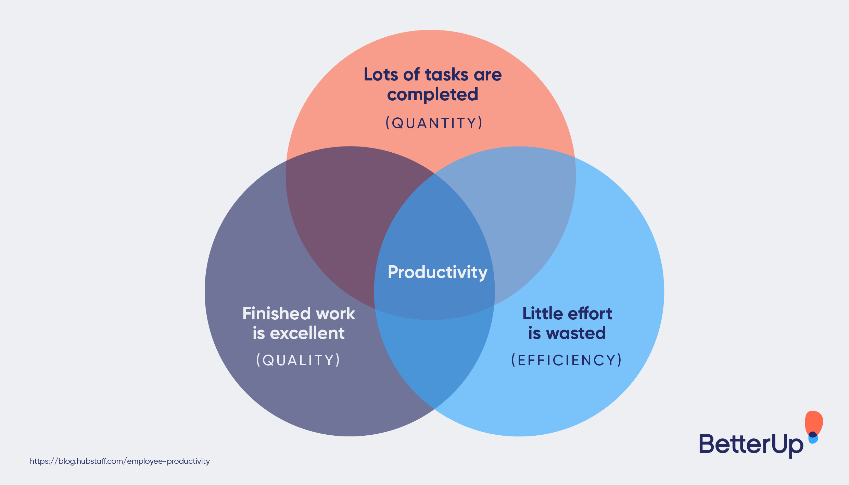
Enhanced Productivity
AFCTW
Fast communication tools boost productivity.
E.g.: Businesses make quicker decisions and remote teams collaborate effectively.

Slide 6
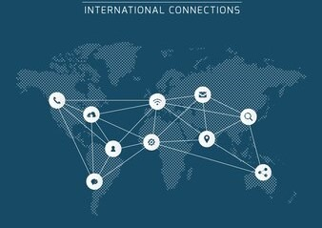
Global Connectivity
AFCTW
Fast communication bridges global gaps.
E.g.: Social media and messaging apps connect people worldwide.

Slide 7

Real-time Information
AFCTW
Access to real-time news and information.
E.g.: Staying informed about current events through online sources.

Slide 8

Cost Savings and Environmental Impact
AFCTW
Fast communication reduces costs and benefits the environment.
E.g.: Businesses save on travel expenses, and digital communication reduces carbon emissions.

Slide 9

Summary
INTRODUCTION
Enhanced Productivity
Global Connectivity
Real-time Information
Cost Savings and Environmental Impact

Slide 10



THANK YOU
TEAM 6 MEMBERS
+91 1234567890
TEAM6@COUCHPOTATOES.COM
TEAM COUCHPOTATOES

